Slide 1
Module: C/C++
University Mohammed VI - A lkhwarizmi
instructor: Nouredine Ouhaddou
September 15, 2022

Slide 2
Outline of lecture
Overview of C language
C language Components
Bitwise operators
How C compiler works
C from hardware part
Libraries in C

Slide 3
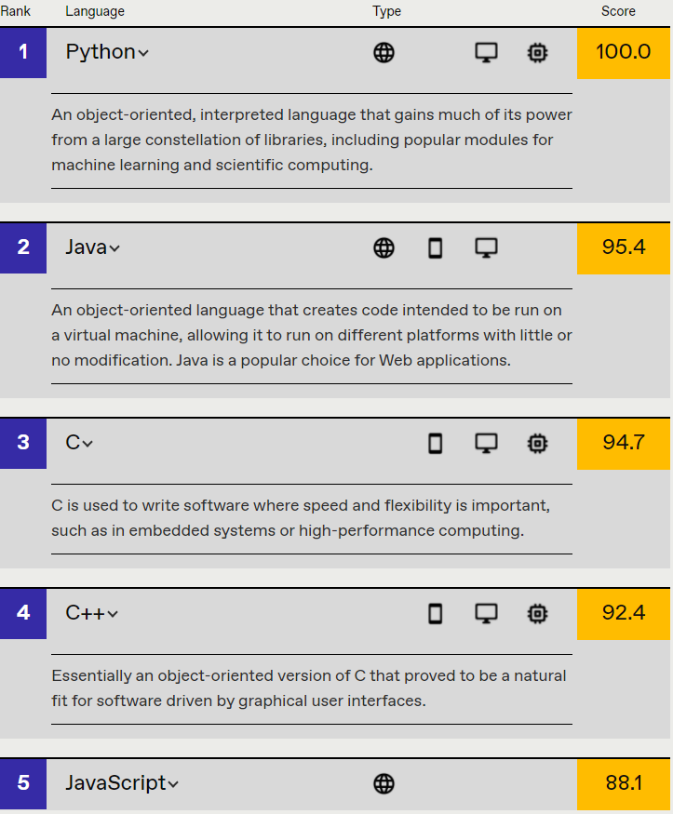
Overview
C is a general-purpose programming language that is extremely popular, simple, and flexible to use. It is a structured programming language that is machine-independent and extensively used to write various applications, Operating Systems like Windows, and many other complex programs like Oracle database, Git, Python interpreter, and more.
It is said that ‘C’ is a god’s programming language. One can say, C is a base for the programming. If you know ‘C,’ you can easily grasp the knowledge of the other programming languages that uses the concept of ‘C

Slide 4
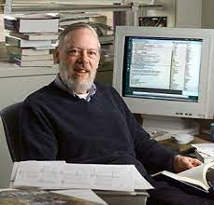
History of C Language
ANSI C revised by ANSI Committee
C 99 Revised by C standard committee
Introduce of C language by Dennis Ritchie (traditional C)
1972
1978
1989
1990
1999
K & RC developed by Brian Kernighan & Dennis Ritchie
ANSI C / ISO C revised by ISO Committee
Notes:
1972 C developed at Bell labs to construct utilities running of Unix, it was applied to re-implementing the kernel of Linux.
In 1980 C gradually gained popularity it has became one of the most widely used programming language.
With C compilers from various vendors available for the majority of existing computer architectures C has been standardized by ANSI 1989.

Slide 5
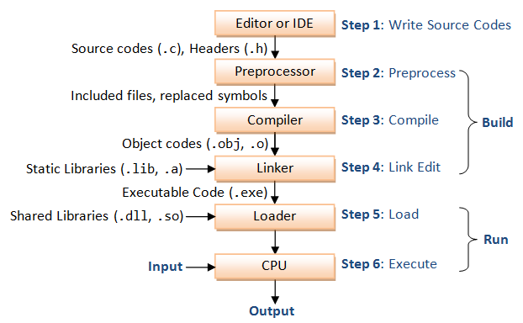
Compiler
Def: A compiler is a program that converts the high-level language into the machine language
Instructor: N. Ouhaddou
MSDA - Al Khwarizmi (LSD S3)

Slide 6
Bitwise Operators
AND
A | B | A & B
1 | 1 | 1
1 | 0 | 0
0 | 1 | 0
0 | 0 | 0
OR
A | B | A | B
1 | 1 | 1
1 | 0 | 1
0 | 1 | 1
0 | 0 | 0
XOR
A | B | A ^ B
1 | 1 | 0
1 | 0 | 1
0 | 1 | 1
0 | 0 | 0
NOT
A | ~ A
1 | 0
0 | 1
Left shifting
Right shifting
1 | 1 | 1 | 1 | 1 | 1 | 1 | 1
1 | 1 | 1 | 1 | 1 | 1 | 1 | 1
1 | 1 | 1 | 1 | 1 | 1 | 1 | 0
0 | 1 | 1 | 1 | 1 | 1 | 1 | 1
Instructor: N. Ouhaddou
MSDA - Al Khwarizmi (LSD S3)

Slide 7
Libraries in C language
DRY
As a programmer, you may find yourself using the same function or functions repeatedly. In this case, it is best to put this function or functions in a library to speed up the compilation of the program, This is good for program modularity, and code reuse. Write Once, Use Many..
Static Library
Shared Library
A static library, also known as a statically-linked library, is a set of functions and variables which are grouped together for the main program to run
A dynamic library (shared library) is similar to a static library in that it allows you to reuse code in a more compact manner, however, a dynamic library does this more efficiently and with a little more flexibility.
Create Static Library
Create Shared Library
> Create object code
gcc -c file1.c file2.c -o file1.o file2.o
> Create library
ar rcs lib_mylib.a file1.o file2.o
> Create object code
gcc -fPIC -c file1.c file2.c -o file1.o file2.o
> Create library
gcc -shared -o lib_mylib.so file1.o file2.o
Using Static Library
Using Shared Library
gcc -o foo foo.c -L. -l_mylib
gcc -o foo foo.o -L. -l_mylib
Instructor: N. Ouhaddou
MSDA - Al Khwarizmi (LSD S3)
Notes:
The -fPIC option is to tell the compiler to create Position Independent Code (create libraries using relative addresses rather than absolute addresses because these libraries can be loaded multiple times). The -shared option is to specify that an architecture-dependent shared library is being created. However, not all platforms support this flag.

Slide 8
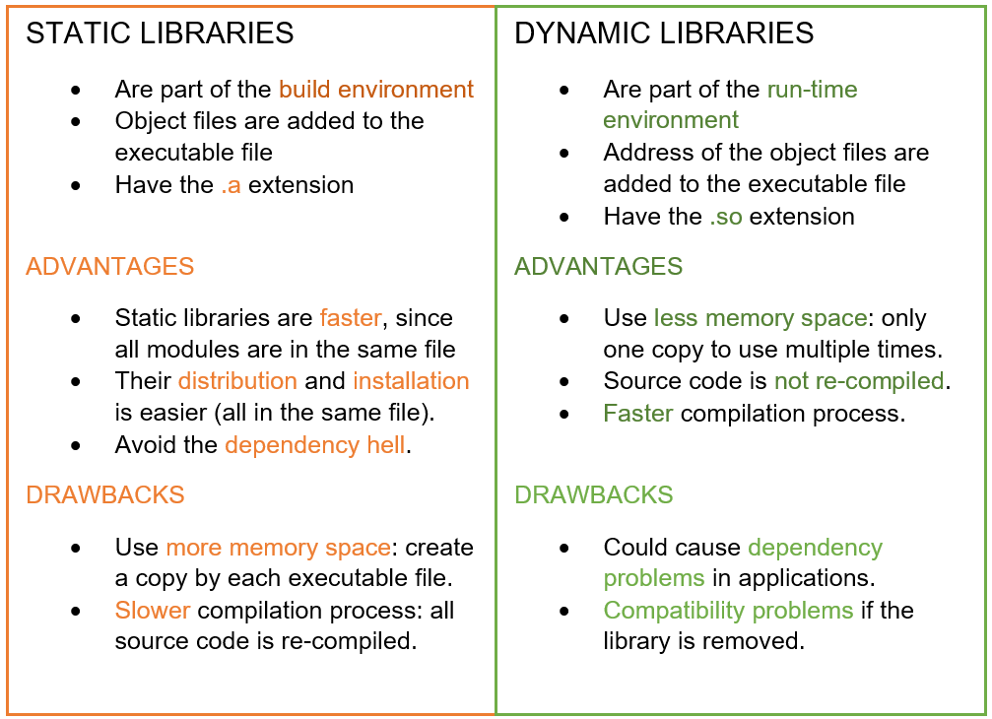
Static vs Dynamic library
Instructor: N. Ouhaddou
MSDA - Al Khwarizmi (LSD S3)

Slide 9
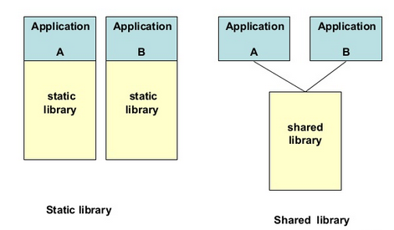
Two application one using shared library another using dynamic library
Instructor: N. Ouhaddou
MSDA - Al Khwarizmi (LSD S3)

Slide 10
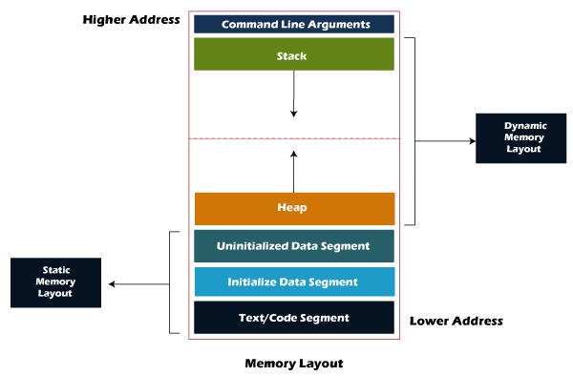
Memory layout of C program
Text segment:
Text segment contains executable instructions of your C program, it’s also called code segment also.
Initialized data segment:
It contains both static and global data that initialized with non-zero values
Uninitialized data segment:
contains all global and static variables that initialized to zero or do not have explicit initialization in source code.
Stack:
The stack segment is an area where local variables stored. By saying local variable means that all those variables which are declared in every function including main() in your C program
Heap:
The heap segment is an area where dynamically allocated memory (allocated by malloc(), calloc(), realloc() ) resides.
Instructor: N. Ouhaddou -
MSDA - Al Khwarizmi (LSD S3)

Slide 11
Makefiles in C
Makefile is a set of commands (similar to terminal commands) with variable names and targets to create object file and to remove them. In a single make file we can create multiple targets to compile and to remove object, binary files. You can compile your project (program) any number of times by using Makefile. The main idea of this file is to specify the dependencies.
Makefile Syntax:
Target : Dependencies
(TAB) Commands #shell commands
The targets are file names, separated by spaces. Typically, there is only one per rule.
The commands are a series of steps typically used to make the target(s). These need to start with a tab character, not spaces.
The prerequisites are also file names, separated by spaces. These files need to exist before the commands for the target are run. These are also called dependencies

Slide 12
Makefiles content
Rules : implicit , explicit
Variables (macros)
# Sign - comment everything till the end of the line.
\ Sign - To separate on command line on two lines.

Slide 13
Makefile: Variables
No variables
Using variables
C = gcc
OBJS = eval.o main.o
my_prog : eval.o main.o
$(C) -o my_prog $(OBJS)
eval.o : eval.c
$(C) –c eval.c
main.o : main.c
$(C) –c main.c
my_prog : eval.o main.o
gcc -o my_prog eval.o main.o
eval.o : eval.c
gcc -c eval.c
main.o : main.c
gcc -c main.c

Slide 14
Pointers in C
A pointer is a variable which stores the address of another variable.
Declaration of a pointer:
Syntax : datatype *pointername;
Pointername = &variablename;
Example : int *ptr;
Int *str;
Why pointers are used:
To return more that one value from a function.
To pass arrays and strings more conveniently to functions.
To allocate memory and access it (Dynamic Memory Allocation)
To create complex data structures such as linked lists, where one data structure must have a reference to other data structures.

Slide 15
Pointers in C
Example:
Int a;
int *ptr;
ptr = &a;
Variable | Value | Address
a | 44 | 333
ptr | 333 | 5443

Slide 16
Pointer Arethmetic
Addition and subtraction are the only operations that can be performed on a pointer
Take a look at the following example:
If we supposed var is stored at the address 200, then the value of Ptr is 204 after the incrementation, because integers are stored in 4 bytes.
Each time a pointer is incremented it points to the memory location of the next element of its type.
Each time a pointer is decremented it points to the memory location of the previous element of its type.
Int var, *Ptr;
var = 300;
Ptr = &var;
Ptr++;

Slide 17
Pointers special operators:
& : Returns the memory address of the operand
* : It is the complement of ‘& ’ . It returns the value contained in the memory
Address pointed to by the operand(pointer).
Example:
Int *ptr, var;
Var = 300;
Ptr = &var //ptr will store the address of var
printf(“%d”, *ptr) //will print 300

Slide 18
Function pointer
A function pointer (pointer to function) are like normal pointers but they have the capability to point to a function
First Method
Second Method
int add(int a, int b)
{
return a + b;
}
int main()
{
int (*ptr)(int, int) = add;
int result = ptr(1, 2);
printf("%d", result);
return 0;
}
int add(int a, int b)
{
return a + b;
}
int main()
{
int (*ptr)(int, int) = &add;
int result = *ptr(1, 2);
printf("%d", result);
return 0;
}
int *f(int a); /* function f returning an int* */
int (*g)(int a); /* pointer g to a function returning an int */
Instructor: N. Ouhaddou -
MSDA - Al Khwarizmi (LSD S3)
Notes:
Think of a function as a set of instructions stored in memory (inst 1, inst 2 … ) with an address.
Ex : int *ptr[10].
Precedence of operators.(precedence of [] is higher than *)

Slide 19
Function pointer properties and use cases
A function pointer points to code, not data.
Unlike normal pointers, we do not allocate de-allocate memory using function pointers.
We can have an array of function pointers.
Like normal data pointers, a function pointer can be passed as an argument and can also be returned from a function.
#include <stdio.h>
void add(int a, int b) { printf("Addition is %d\n", a+b);}
void subtract(int a, int b) { printf("Subtraction is %d\n", a-b);}
void multiply(int a, int b) {printf("Multiplication is %d\n", a*b);}
int main()
{
void (*fun_ptr_arr[])(int, int) = {add, subtract, multiply};
unsigned int ch, a = 15, b = 10;
printf("Enter number of the operation:\n0: add\n1: subtract\n2: multiply\n");
scanf("%d", &ch);
if (ch <= 2)
(*fun_ptr_arr[ch])(a, b);
return 0;
}
Function as argument syntax
void func ( void (*f)(int) );
Instructor: N. Ouhaddou -
MSDA - Al Khwarizmi (LSD S3)
Notes:
Think of a function as a set of instructions stored in memory (inst 1, inst 2 … ) with an address.
Ex : int *ptr[10].
Precedence of operators.(precedence of [] is higher than *)

